Slide 1
2D Transformations
Notes:
Need to include coordinate transform and hierarchical modeling

Slide 2
2D Transformations
y
y
x
x
y
x

Slide 3
2D Transformations
OpenGl transformations:
glTranslatef (tx, ty, tz);
glRotatef (theta, vx, vy, vz)
glScalef (sx,sy,sz)
……
y
y
x
x
y
x

Slide 4
2D Transformations
y
y
x
Applications:
Animation
Image/object manipulation
Viewing transformation
etc.
x
y
x

Slide 5
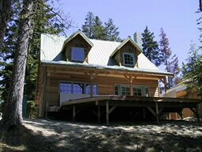
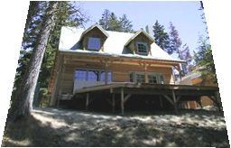
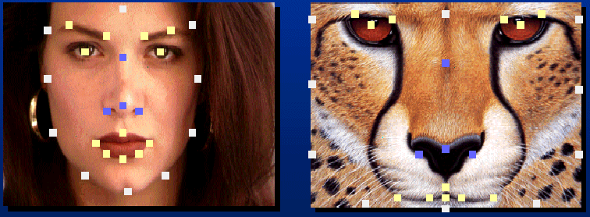

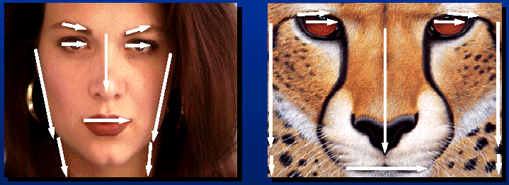
Applications of 2D Transformations
2D geometric transformations
Animation (demo ,demo)
Image warping
Image morphing

Slide 6
2D Transformation
Given a 2D object, transformation is to change the object’s
  Position (translation)
  Size (scaling)
  Orientation (rotation)
  Shapes (shear)
Apply a sequence of matrix multiplications to the object vertices

Slide 7
Point Representation
We can use a column vector (a 2x1 matrix) to represent a 2D point x
y
A general form of linear transformation can be written as:
x’ = ax + by + c
OR
y’ = dx + ey + f
X’ a b c x
Y’ = d e f * y
1 0 0 1 1

Slide 8
Translation
Re-position a point along a straight line
Given a point (x,y), and the translation distance (tx,ty)
The new point: (x’, y’)
x’ = x + tx
y’ = y + ty
(x’,y’)
ty
(x,y)
tx
OR P’ = P + T where P’ = x’ p = x T = tx
y’ y ty

Slide 9
3x3 2D Translation Matrix
x’ = x + tx
y’ y ty
Use 3 x 1 vector
x’ 1 0 tx x
y’ = 0 1 ty * y
1 0 0 1 1
Note that now it becomes a matrix-vector multiplication

Slide 10
Translation
How to translate an object with multiple vertices?
Translate individual
vertices

Slide 11
2D Rotation
Default rotation center: Origin (0,0)
y
> 0 : Rotate counter clockwise
θ
o
x
y
< 0 : Rotate clockwise
θ
o
x

Slide 12
2D Rotation
(x,y) -> Rotate about the origin by θ
(x’,y’)
(x’, y’)
θ
(x,y)
r
φ
How to compute (x’, y’) ?

Slide 13
2D Rotation
(x,y) -> Rotate about the origin by θ
y
(x’,y’)
(x’, y’)
θ
(x,y)
r
φ
How to compute (x’, y’) ?
o
x
x = r cos (φ) y = r sin (φ)
x’ = r cos (φ + θ) y’ = r sin (φ + θ)

Slide 14
2D Rotation
(x’,y’)
x = r cos (φ) y = r sin (φ)
x’ = r cos (φ + θ) y’ = r sin (φ + θ)
(x,y)
θ
r
φ
x’ = r cos (φ + θ)
= r cos(φ) cos(θ) – r sin(φ) sin(θ)
= x cos(θ) – y sin(θ)
y’ = r sin (φ + θ)
= r sin(φ) cos(θ) + r cos(φ)sin(θ)
= y cos(θ) + x sin(θ)

Slide 15
2D Rotation
(x’,y’)
x’ = x cos(θ) – y sin(θ)
y’ = y cos(θ) + x sin(θ)
θ
r
(x,y)
φ
Matrix form?
x’ cos(θ) -sin(θ) x
y’ sin(θ) cos(θ) y
=
3 x 3?

Slide 16
3x3 2D Rotation Matrix
x’ cos(θ) -sin(θ) x
y’ sin(θ) cos(θ) y
(x’,y’)
=
θ
r
(x,y)
φ
x’ cos(θ) -sin(θ) 0 x
y’ sin(θ) cos(θ) 0 y
1 0 0 1 1
=

Slide 17
2D Rotation
How to rotate an object with multiple vertices?
Rotate individual
Vertices
θ

Slide 18
2D Scaling
Scale: Alter the size of an object by a scaling factor
(Sx, Sy), i.e.
x’ = x . Sx
y’ = y . Sy
x’ Sx 0 x
y’ 0 Sy y
=
(4,4)
(2,2)
Sx = 2, Sy = 2
(2,2)
(1,1)

Slide 19
2D Scaling
(4,4)
(2,2)
Sx = 2, Sy = 2
(2,2)
(1,1)
Not only the object size is changed, it also moved!!
Usually this is an undesirable effect

Slide 20
3x3 2D Scaling Matrix
x’ Sx 0 x
y’ 0 Sy y
=
x’ Sx 0 0 x
y’ = 0 Sy 0 * y
1 0 0 1 1

Slide 21
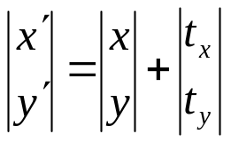
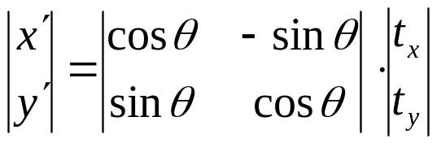
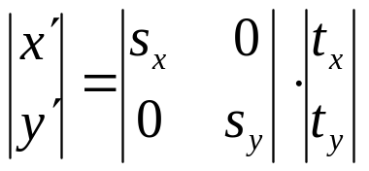
Put it all together
Translation:
Rotation:
Scaling:

Slide 22
Or, 3x3 Matrix Representations
Translation:
Rotation:
Scaling:
x’ 1 0 tx x
y’ = 0 1 ty * y
1 0 0 1 1
x’ cos(θ) -sin(θ) 0 x
y’ sin(θ) cos(θ) 0 * y
1 0 0 1 1
=
x’ Sx 0 0 x
y’ = 0 Sy 0 * y
1 0 0 1 1
Why use 3x3 matrices?

Slide 23
Why Use 3x3 Matrices?
So that we can perform all transformations using matrix/vector multiplications
This allows us to pre-multiply all the matrices together
The point (x,y) needs to be represented as
(x,y,1) -> this is called Homogeneous
coordinates!
How to represent a vector (v_{x},v_{y})?

Slide 24
Why Use 3x3 Matrices?
So that we can perform all transformations using matrix/vector multiplications
This allows us to pre-multiply all the matrices together
The point (x,y) needs to be represented as
(x,y,1) -> this is called Homogeneous
coordinates!
How to represent a vector (v_{x},v_{y})? (v_{x},v_{y},0)

Slide 25
Shearing
Y coordinates are unaffected, but x coordinates are translated linearly with y
That is:
  y’ = y
  x’ = x + y * h
x 1 h 0 x
y = 0 1 0 * y
1 0 0 1 1

Slide 26
Shearing in Y
x 1 0 0 x
y = g 1 0 * y
1 0 0 1 1
Interesting Facts:
A 2D rotation is three shears
Shearing will not change the area of the object
Any 2D shearing can be done by a rotation, followed by a scaling, and followed by a rotation

Slide 27
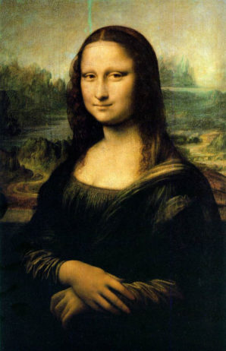
Reflection

Slide 28
Reflection

Slide 29
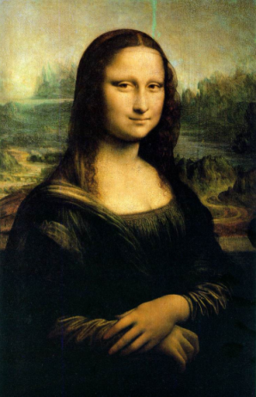
Reflection

Slide 30


Reflection about X-axis

Slide 31
Reflection about X-axis
x 1 0 0 x
y = 0 -1 0 * y
1 0 0 1 1

Slide 32
Reflection about Y-axis

Slide 33
Reflection about Y-axis
x -1 0 0 x
y = 0 1 0 * y
1 0 0 1 1

Slide 34

What’s the Transformation Matrix?

Slide 35
What’s the Transformation Matrix?
x -1 0 0 x
y = 0 -1 0 * y
1 0 0 1 1

Slide 36
Rotation Revisit
The standard rotation matrix is used to rotate about the origin (0,0)
cos(θ) -sin(θ) 0
sin(θ) cos(θ) 0
0 0 1
What if I want to rotate about an arbitrary center?

Slide 37
Arbitrary Rotation Center
To rotate about an arbitrary point P (px,py) by θ:
(px,py)

Slide 38
Arbitrary Rotation Center
To rotate about an arbitrary point P (px,py) by θ:
  Translate the object so that P will coincide with the origin: T(-px, -py)
(px,py)

Slide 39

Arbitrary Rotation Center
To rotate about an arbitrary point P (px,py) by θ:
  Translate the object so that P will coincide with the origin: T(-px, -py)
  Rotate the object: R(θ)
(px,py)

Slide 40
Arbitrary Rotation Center
To rotate about an arbitrary point P (px,py) by θ:
  Translate the object so that P will coincide with the origin: T(-px, -py)
  Rotate the object: R(θ)
  Translate the object back: T(px,py)
(px,py)

Slide 41
Arbitrary Rotation Center
  Translate the object so that P will coincide with the origin: T(-px, -py)
  Rotate the object: R(θ)
  Translate the object back: T(px,py)
Put in matrix form: T(px,py) R(θ) T(-px, -py) * P
x’ 1 0 px cos(θ) -sin(θ) 0 1 0 -px x
y’ = 0 1 py sin(θ) cos(θ) 0 0 1 -py y
1 0 0 1 0 0 1 0 0 1 1

Slide 42
Scaling Revisit
The standard scaling matrix will only anchor at (0,0)
Sx 0 0
0 Sy 0
0 0 1
What if I want to scale about an arbitrary pivot point?

Slide 43
Arbitrary Scaling Pivot
To scale about an arbitrary fixed point P (px,py):
(px,py)

Slide 44
Arbitrary Scaling Pivot
To scale about an arbitrary fixed point P (px,py):
  Translate the object so that P will coincide with the origin: T(-px, -py)
(px,py)

Slide 45
Arbitrary Scaling Pivot
To scale about an arbitrary fixed point P (px,py):
  Translate the object so that P will coincide with the origin: T(-px, -py)
  Scale the object: S(sx, sy)
(px,py)

Slide 46
Arbitrary Scaling Pivot
To scale about an arbitrary fixed point P (px,py):
  Translate the object so that P will coincide with the origin: T(-px, -py)
  Scale the object: S(sx, sy)
  Translate the object back: T(px,py)
(px,py)

Slide 47
Reflection about An Arbitrary Line

Slide 48

Reflection about An Arbitrary Line
  Rotate the object to align the reflection vector with x axis:

Slide 49
Reflection about An Arbitrary Line
  Rotate the object to align the reflection vector with x axis:
  Reflect the object

Slide 50


Reflection about An Arbitrary Line
  Rotate the object to align the reflection vector with x axis:
  Reflect the object
  Rotate the object back:

Slide 51
Affine Transformation
Translation, Scaling, Rotation, Shearing are all affine transformation

Slide 52
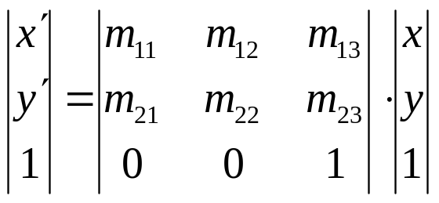
Affine Transformation
Translation, Scaling, Rotation, Shearing are all affine transformation
Affine transformation – transformed point P’ (x’,y’) is a linear combination of the original point P (x,y), i.e.

Slide 53
Affine Transformation
Translation, Scaling, Rotation, Shearing are all affine transformation
Affine transformation – transformed point P’ (x’,y’) is a linear combination of the original point P (x,y), i.e.
Any 2D affine transformation can be decomposed into a rotation, followed by a scaling, followed by a shearing, and followed by a translation.
Affine matrix = translation x shearing x scaling x rotation

Slide 54
Composing Transformation
Composing Transformation – the process of applying several transformation in succession to form one overall transformation
If we apply transforming a point P using M1 matrix first, and then transforming using M2, and then M3, then we have:
(M3 x (M2 x (M1 x P )))

Slide 55
Composing Transformation
Composing Transformation – the process of applying several transformation in succession to form one overall transformation
If we apply transforming a point P using M1 matrix first, and then transforming using M2, and then M3, then we have:
(M3 x (M2 x (M1 x P ))) = M3 x M2 x M1 x P
(pre-multiply)
M

Slide 56
Arbitrary Rotation Center
(px,py)
x’ 1 0 px cos(θ) -sin(θ) 0 1 0 -px x
y’ = 0 1 py sin(θ) cos(θ) 0 0 1 -py y
1 0 0 1 0 0 1 0 0 1 1

Slide 57
Arbitrary Rotation Center
(px,py)
x’ 1 0 px cos(θ) -sin(θ) 0 1 0 -px x
y’ = 0 1 py sin(θ) cos(θ) 0 0 1 -py y
1 0 0 1 0 0 1 0 0 1 1
M3
M2
M1
M= M3*M2*M1

Slide 58
Composing Transformation
Matrix multiplication is associative
M3 x M2 x M1 = (M3 x M2) x M1 = M3 x (M2 x M1)
Transformation products may not be commutative A x B != B x A

Slide 59
Transformation Order Matters!
Example: rotation and translation are not commutative
Translate (5,0) and then Rotate 60 degree
OR
Rotate 60 degree and then translate (5,0)??
Rotate and then translate !!

Slide 60
Composing Transformation
Matrix multiplication is associative
M3 x M2 x M1 = (M3 x M2) x M1 = M3 x (M2 x M1)
Transformation products may not be commutative A x B != B x A
Some cases where A x B = B x A
A B
translation translation
scaling scaling
rotation rotation

Slide 61
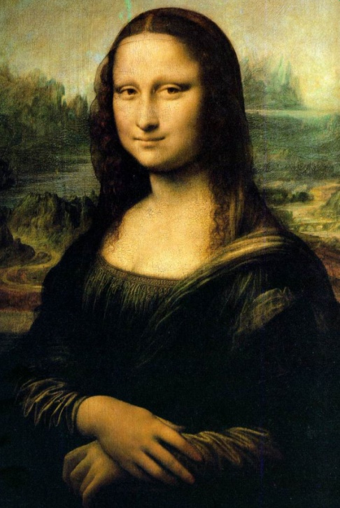
Finding Affine Transformations
How many points determines affine transformation

Slide 62

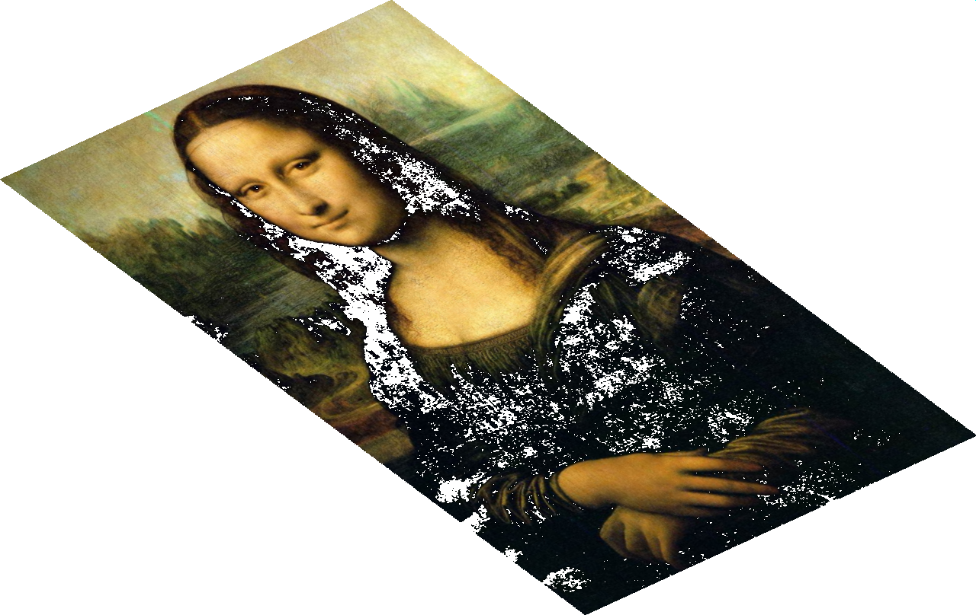
Finding Affine Transformations
How many points determines affine transformation

Slide 63



Finding Affine Transformations
Image of 3 points determines affine transformation
r
P
p’
q
r’
q’

Slide 64
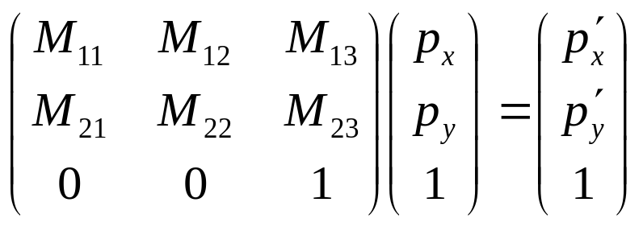
Finding Affine Transformations
Image of 3 points determines affine transformation
P
p’

Slide 65
Finding Affine Transformations
Image of 3 points determines affine transformation
P
p’
- Each pair gives us 2 linear equations on 6 unknowns!
- In total, 6 unknowns 6 linear equations.

Slide 66
Finding Affine Transformations
Image of 3 points determines affine transformation
P
p’

Slide 67
Finding Affine Transformations
Image of 3 points determines affine transformation
r
P
p’
q
r’
q’
pnew
What’s the corresponding point in the right image?

Slide 68
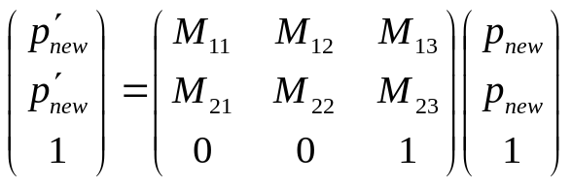
Finding Affine Transformations
Image of 3 points determines affine transformation
r
P
p’
q
r’
q’
pnew
What’s the corresponding point in the right image?

